Slide 1
Vista
Overcurrent Control 2.0
Notes:
One thing we know: when you add more controls to the system, you add potential complexity--and that can add cost and hurt reliability.
This can affect your organization in a number of ways. First, when it comes to the initial set-up and programming. How difficult is it to make sure you have the right settings loaded in your control? This can add cost and also lead to errors that can cause problems on your system.
Second, when it comes to troubleshooting in the field. How easy is it to access the control and get basic information about it?
And finally, does the control or supporting systems require any maintenance? Are there batteries you need to worry about, for instance?
Overcurrent protection is the economical choice for many underground switching and protection applications, especially when it comes to taps off the main loop

Slide 2
Superior Overcurrent Protection—
With Less Cost and Complexity
Simplified user interface—hardware & software
Expanded overcurrent-protection capabilities
No batteries, no routine maintenance

Slide 3
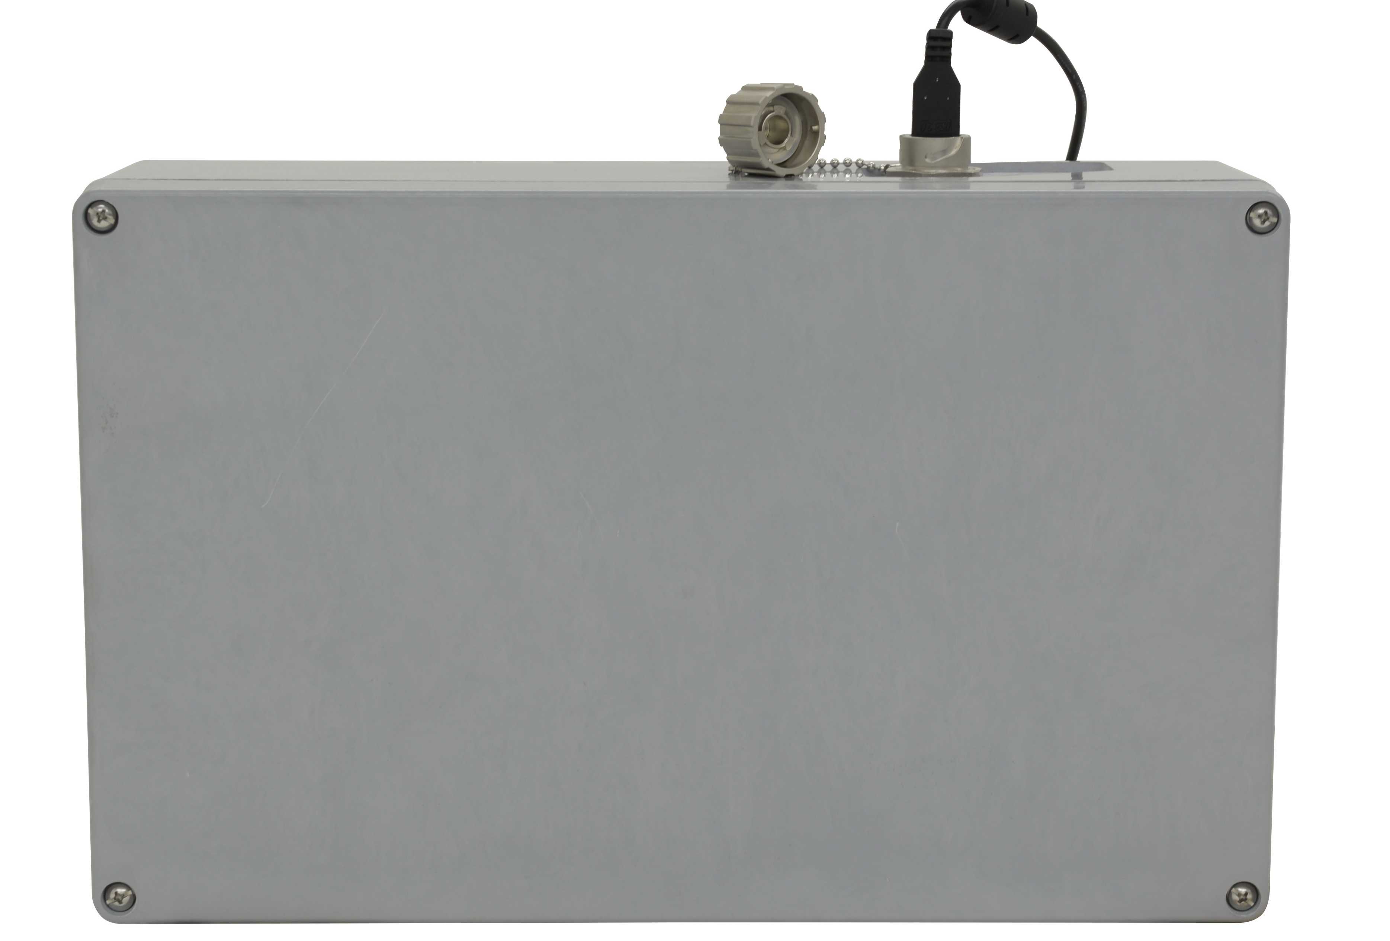
Connect via USB

Slide 4
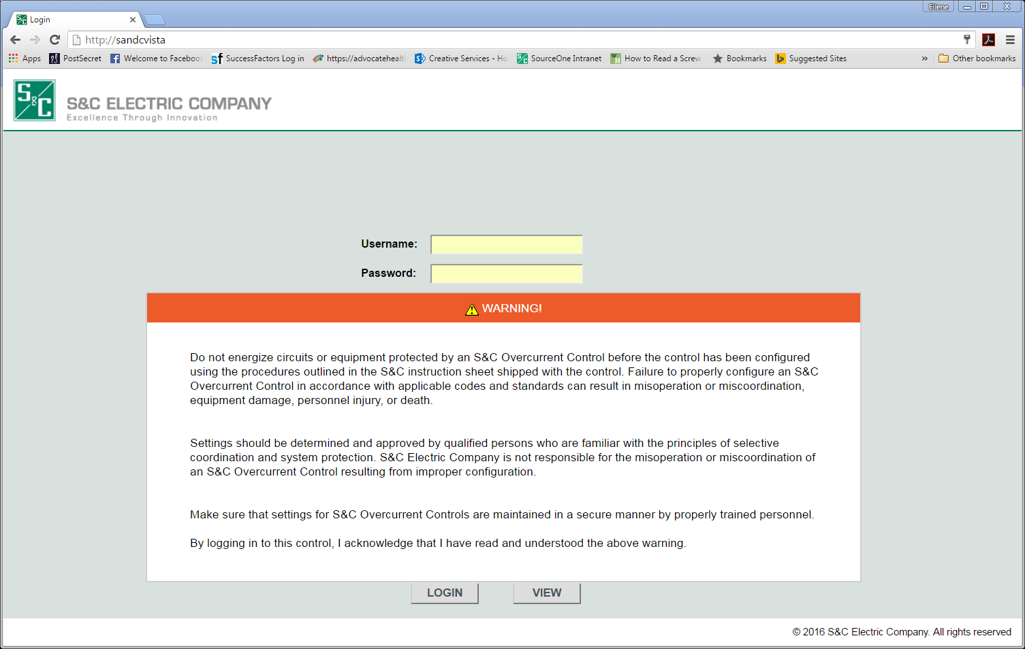
Browser-Based Access
All programming software resident on the control
Notes:
Compatible with Internet Explorer and Firefox

Slide 5
Browser-Based Access
Type in URL:
http://sandcvista/
Notes:
Compatible with Internet Explorer and Firefox

Slide 6
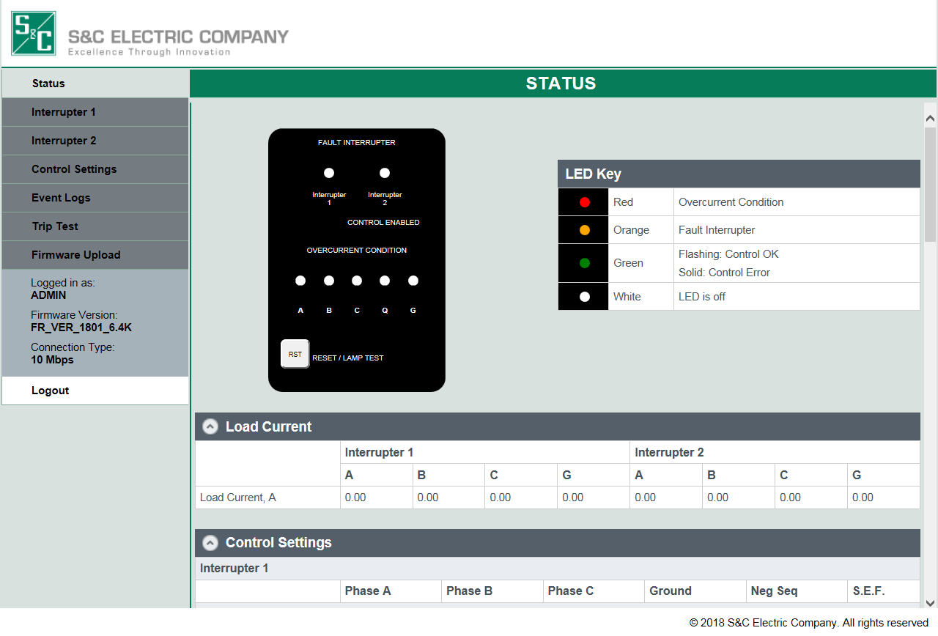
Easy Access to Control Information
View mode includes:
Trip indication
Control health
Control settings
Event logs
Notes:
For routine everyday operations—when you will need to access control with most frequency—make it easy to access information

Slide 7
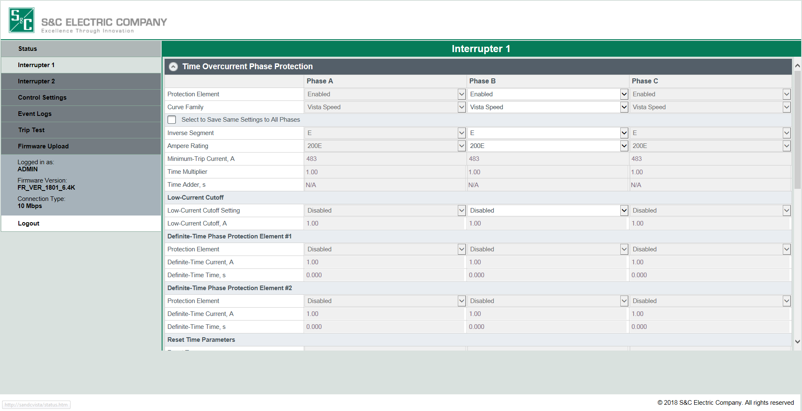
Simple Programming
Notes:
Provides for even finer degrees of coordination

Slide 8
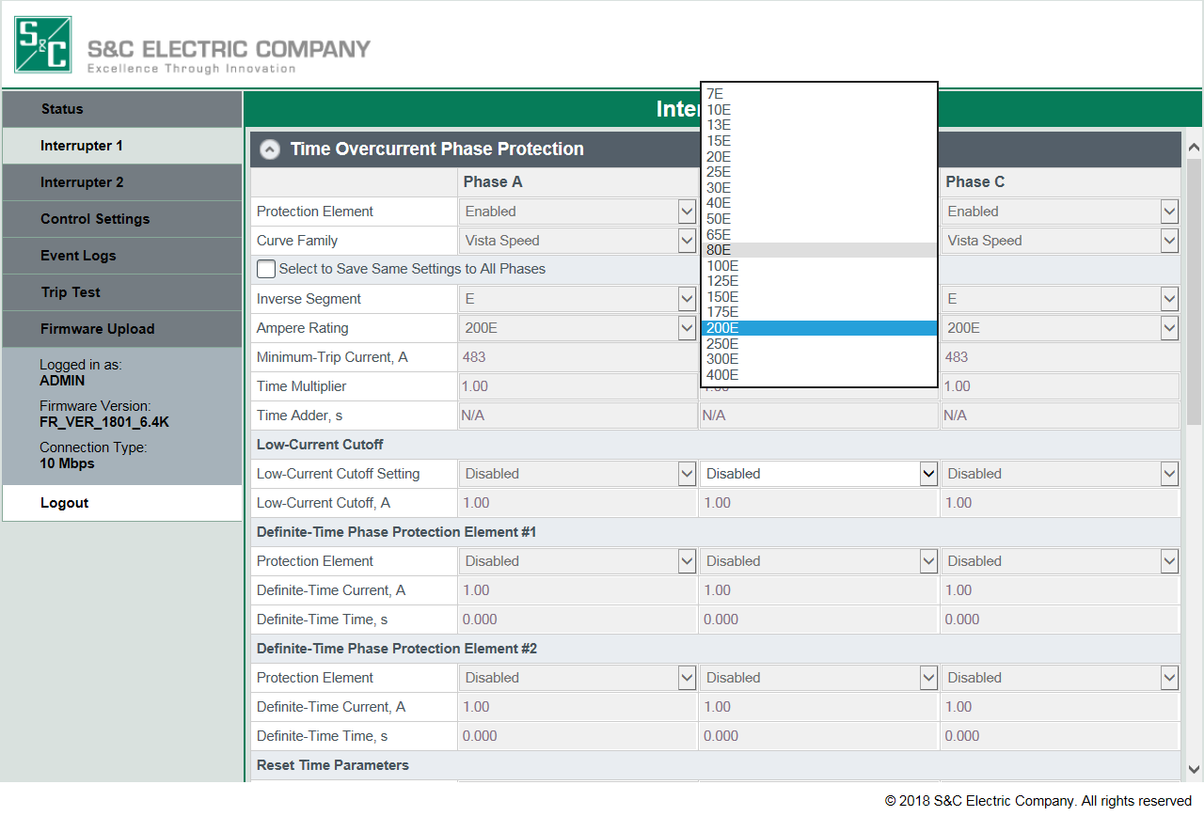
Simple Programming
Notes:
Provides for even finer degrees of coordination

Slide 9
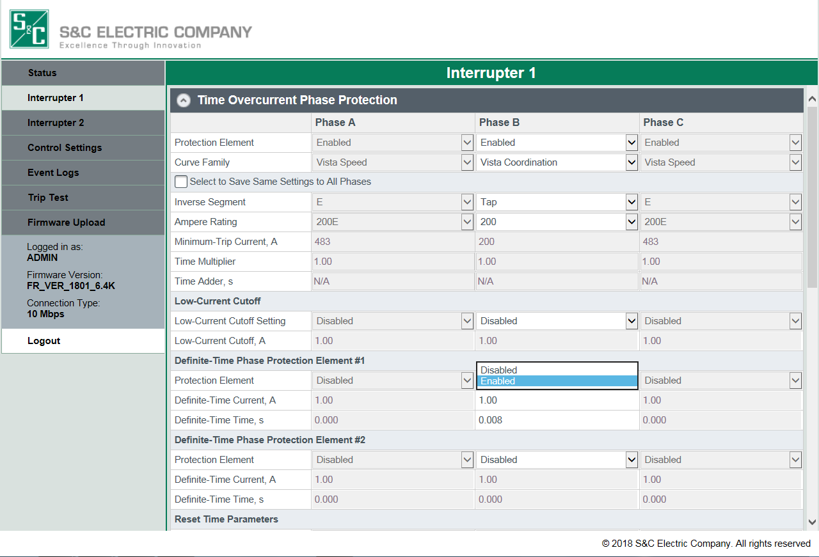
Simple Programming
Notes:
Provides for even finer degrees of coordination

Slide 10
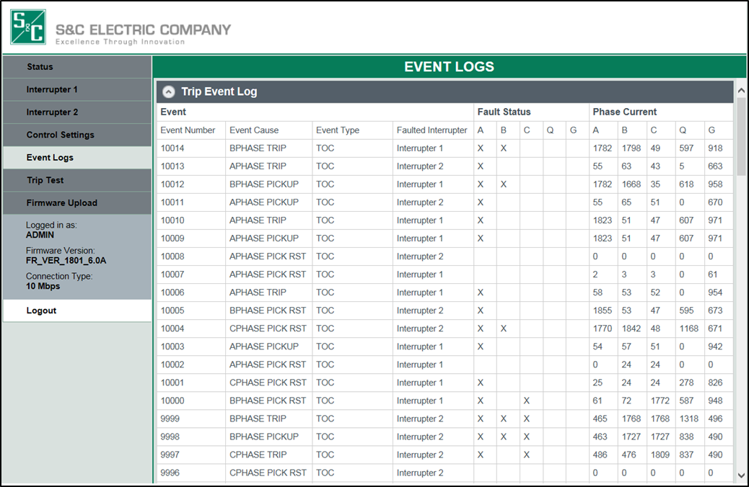
Expanded Event Logs

Slide 11
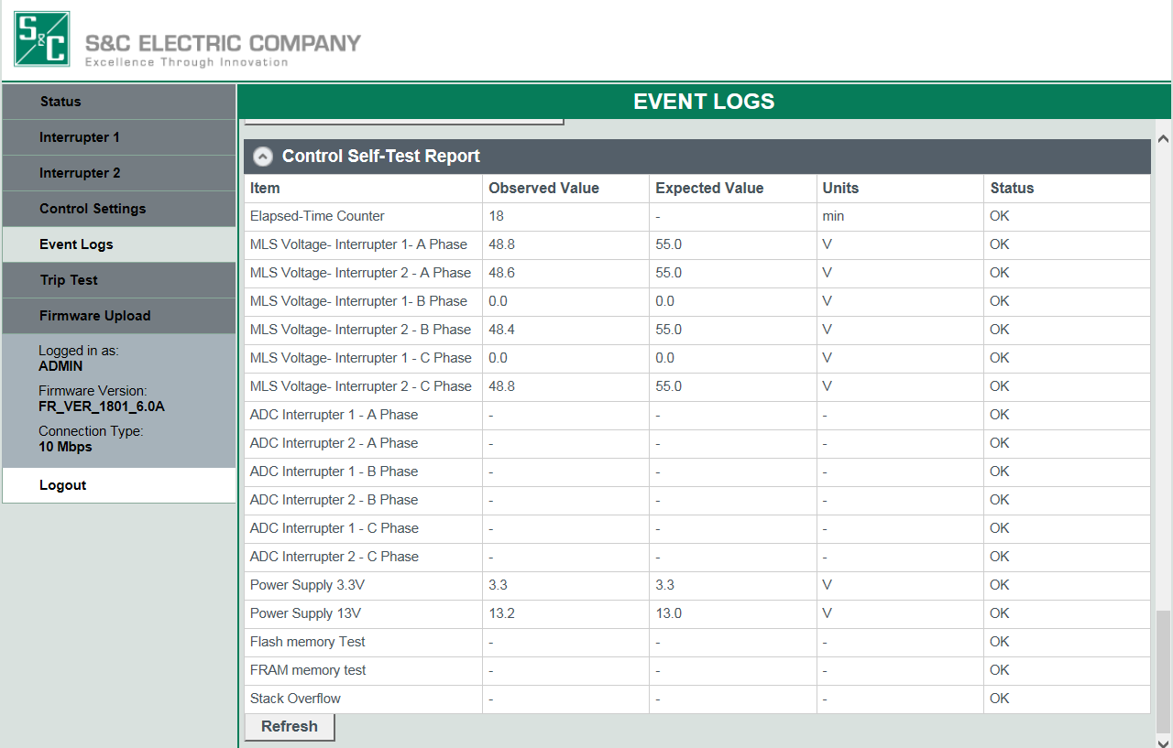
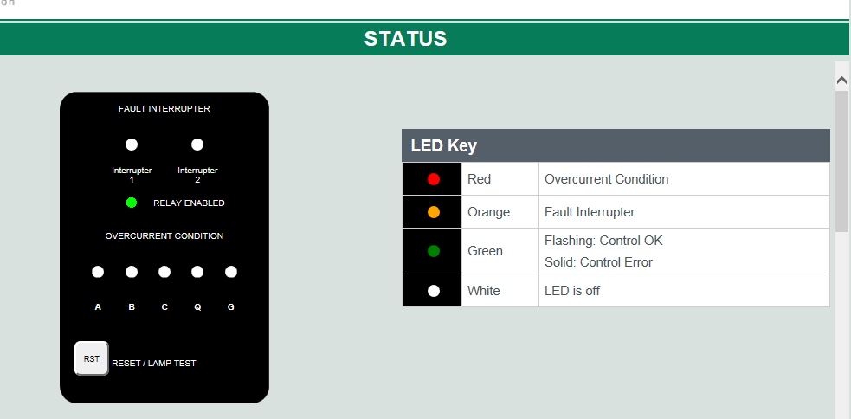
Control Self-Tests

Slide 12
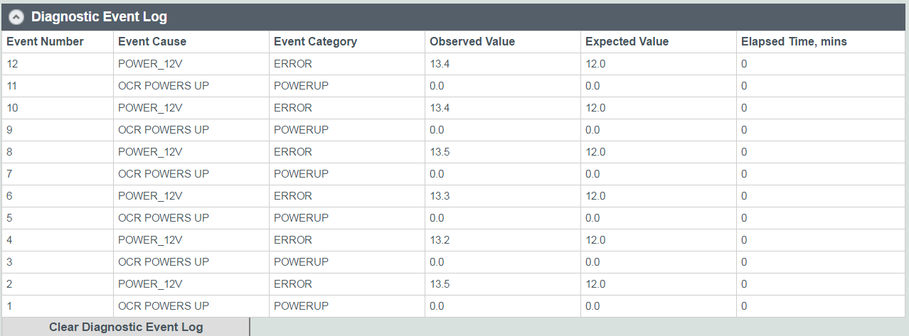
Diagnostic Event Log

Slide 13
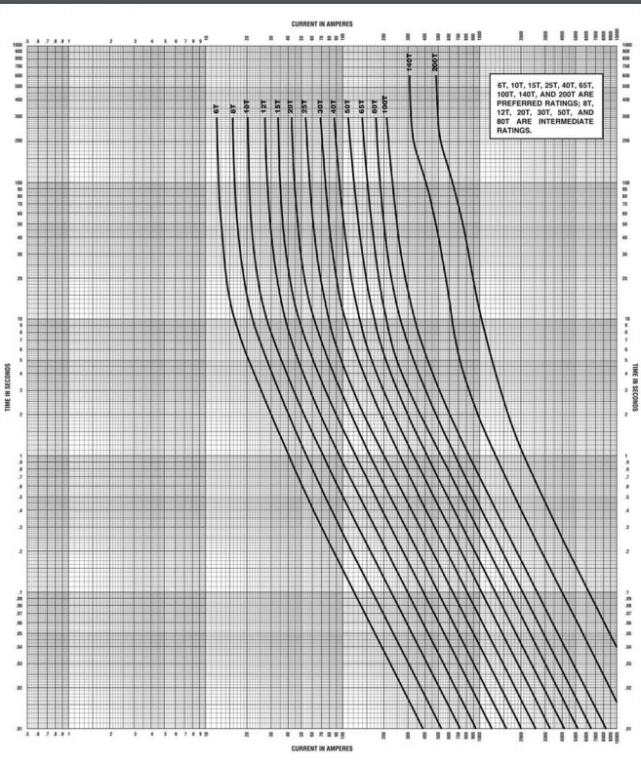
Expanded Overcurrent-Protection Capabilities
Lower minimum trip current
… As low as 14 A
More TCC families
… Now includes “T” curve family

Slide 14
Expanded Overcurrent-Protection Capabilities
Additional Protective Elements
  Negative sequence & sensitive earth fault
Added protective settings

Slide 15
Added Protective Settings
Low-current cutoff
Time-adder
Two definite-time settings
Reset-time parameters
Notes:
All these added capabilities help you go even further in achieving the optimal overcurrent coordination—which plays a key role in the overall reliability of your circuit

